Slide 1
Data Science and artificial intelligence
Overview of the field of Data Science and AI.
Decision Tree and Random Forest.
Abhinaba Chakraborty

Slide 2
WHAT IS DATA SCIENCE?
Data science is a field of applied mathematics where the end goal is to find a solution to a specific business problem using data along with a combination of tools, technologies, algorithms, processes and domain expertise. It usually involves creating prediction models.
HOW IS IT DIFFERENT FROM SOFTWARE ENG.?
Software engineering involves developing applications, processes and functionalities that are serve a business purpose.
Data science involves using data to generate insights and using those historical perceptions to build functional, statistical, ML, DL, RL models that forecast/ predict metrics adjacent to a business interest.
WHY NOW?
Latest advancements in the field of cloud and big data have triggered theories that were earlier difficult to implement and deploy.

Slide 3
WHO IS A DATA SCIENTIST?
Computer
Science
Statistics
Domain
Expertise
Business/Domain Expert:
Ask the right questions to begin the discovery process.
Data Engineering:
Acquire data.
Process and clean the data.
Integrate and store data.
Statistical Analysis/Modeling:
Initial data investigation and exploratory data analysis.
Choose one or more potential models and algorithms
Apply data science methods and techniques, such as ML, statistical modeling and AI.
Measure and improve results.
Make adjustments based on feedback
Data Visualization:
Present final results to stakeholders.
Traditional
Software
Statistical Modeling
Data Scientist
Traditional
Research

Slide 4
PROBLEMS SOLVED BY A DATA SCIENTIST?
Data Science
Supervised Learning
Regression
Classification
Unsupervised Learning
Clustering
Reinforcement Learning
In a supervised learning model, the algorithm learns on a labeled dataset, providing an answer key that the algorithm can use to evaluate its accuracy on training data.
An unsupervised model, in contrast, provides unlabeled data that the algorithm tries to make sense of by extracting features and patterns on its own.
Reinforcement learning is a type of dynamic programming that trains algorithms using a system of reward and punishment. A reinforcement learning algorithm, or agent, learns by interacting with its environment. The agent receives rewards by performing correctly and penalties for performing incorrectly. The agent learns without intervention from a human by maximizing its reward and minimizing its penalty.
Regression: It predicts continuous valued output. The Regression analysis is the statistical model which is used to predict the numeric data instead of labels. It can also identify the distribution trends based on the available data or historic data.
e.g.: Predicting a person’s income from their age, education is example of regression task.
Classification: It predicts discrete number of values. In classification the data is categorized under different labels according to some parameters and then the labels are predicted for the data.
e.g.: Classifying emails as either spam or not spam is example of classification problem.
Clustering: Clustering is the task of partitioning the dataset into groups, called clusters. The goal is to split up the data in such a way that points within single cluster are very similar and points in different clusters are different. It determines grouping among unlabeled data.
e.g.: Grouping customers of similar demographics into clusters for marketing a product.

Slide 5
AI Vs. ML Vs. NLP Vs. DL
Artificial Intelligence
Machine learning
NLP
DL
Expansion of Machine Learning
Classical machine Learning
Modern machine Learning
Advanced machine Learning
Supervised:
Linear Regression
Logistic Regression
Time Series
Naive Bayes
Unsupervised:
Hierarchical Clustering
K-Means Clustering
Supervised:
Decision trees and Random Forest
SVM
GBM
Unsupervised:
DB Scan
Natural Language Processing
Lexical Processing
Syntactic Processing
Semantic Processing
Deep Neural Networks:
Supervised:
ANN
CNN
RNN
Unsupervised:
Auto encoders

Slide 6
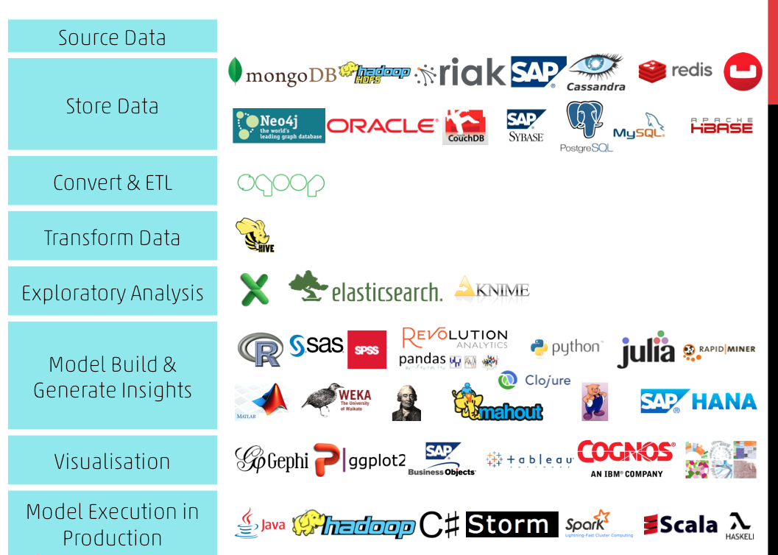

Slide 7
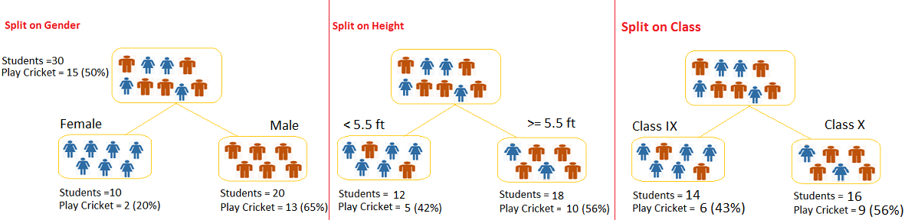
TREE BASED MODELS – DT & RF
Tree based algorithms are considered to be one of the best and mostly used supervised learning methods.
Tree based algorithms empower predictive models with high accuracy, stability and ease of interpretation.
Unlike linear models, they map non-linear relationships quite well.
They are adaptable at solving both classification or regression problems.
CART stands for classification and regression trees where as CHAID represents Chi-Square automatic interaction detector A key difference between the two models, is that CART produces binary splits, one out of two possible outcomes, whereas CHAID can produce multiple branches of a single root/parent node
Let’s say we have a sample of 30 students with three variables Gender (Boy/ Girl), Class( IX/ X) and Height (5 to 6 ft). 15 out of these 30 play cricket in leisure time. Now, I want to create a model to predict who will play cricket during leisure period? In this problem, we need to segregate students who play cricket in their leisure time based on highly significant input variable among all three.
This is where decision tree helps, it will segregate the students based on all values of three variable and identify the variable, which creates the best homogeneous sets of students (which are heterogeneous to each other).
As mentioned, decision tree identifies the most significant variable and it’s value that gives best homogeneous sets of population. Now the question which arises is, how does it identify the variable and the split? To do this, decision tree uses various algorithms, which we will discuss in the following section.

Slide 8
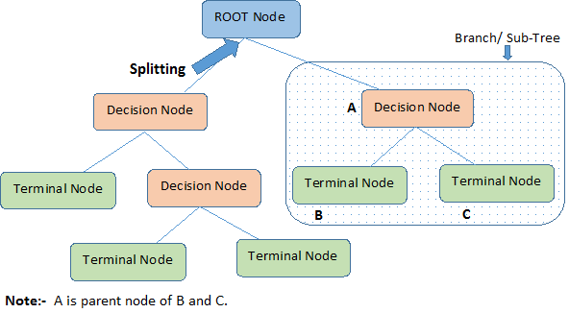
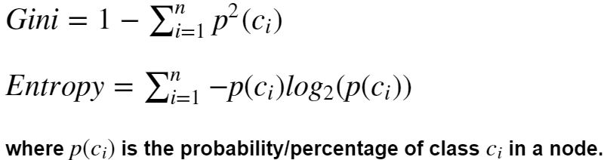
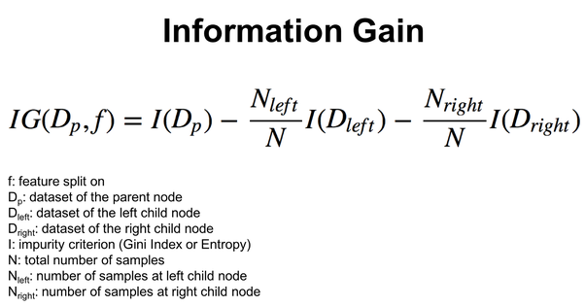
DECISION TREE STRUCTURE
Both gini and entropy are measures of impurity of a node. A node having multiple classes is impure whereas a node having only one class is pure.
The Gini Coefficient or Gini Index measures the inequality among values of a variable. Higher the value of an index, more dispersed is the data. Gini index is the most commonly used measure of inequality. The higher the better.
Entropy, is a measure of the randomness in the information being processed. The higher the entropy, the harder it is to draw any conclusions from that information. Lesser Entropy means higher Information gain.
Root Node: It represents entire population or sample and this further gets divided into two or more homogeneous sets.
Splitting: It is a process of dividing a node into two or more sub-nodes.
Decision Node: When a sub-node splits into further sub-nodes, then it is called decision node.
Leaf/ Terminal Node: Nodes do not split is called Leaf or Terminal node.
Pruning: When we remove sub-nodes of a decision node, this process is called pruning. You can say opposite process of splitting.
Branch / Sub-Tree: A sub section of entire tree is called branch or sub-tree.
Parent and Child Node: A node, which is divided into sub-nodes is called parent node of sub-nodes where as sub-nodes are the child of parent node.

Slide 9
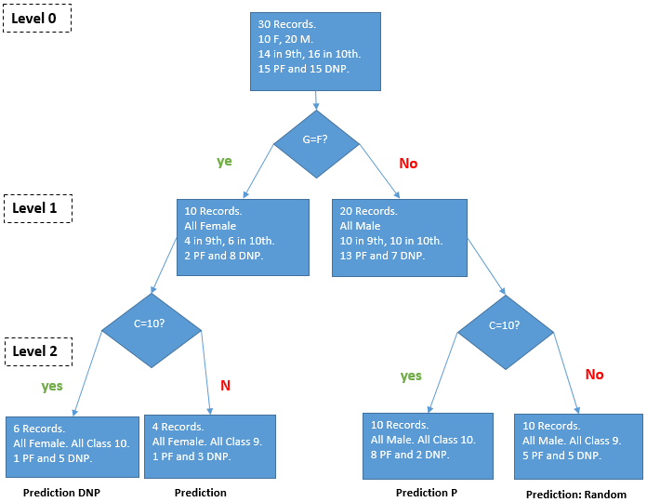
DECISION TREE EXAMPLE
Let’s say we have a data set of 30 students with details like gender, class and play football. We need to prepare a Machine Learning Model that predicts whether a student would play football or Not.

Slide 10
DECISION TREE PROS AND CONS
Advantages
Easy to Understand: Decision tree output is very easy to understand even for people from non-analytical background. It does not require any statistical knowledge to read and interpret them. Its graphical representation is very intuitive and users can easily relate their hypothesis.
Useful in Data exploration: Decision tree is one of the fastest way to identify most significant variables and relation between two or more variables. With the help of decision trees, we can create new variables / features that has better power to predict target variable. It can also be used in data exploration stage. For example, we are working on a problem where we have information available in hundreds of variables, there decision tree will help to identify most significant variable.
Less data cleaning required: It requires less data cleaning compared to some other modeling techniques. It is not influenced by outliers and missing values to a fair degree.
Data type is not a constraint: It can handle both numerical and categorical variables.
Non Parametric Method: Decision tree is considered to be a non-parametric method. This means that decision trees have no assumptions about the space distribution and the classifier structure.
Disadvantages
Over fitting: Over fitting is one of the most practical difficulty for decision tree models. This problem gets solved by setting constraints on model parameters and pruning.
Not fit for continuous variables: While working with continuous numerical variables, decision tree looses information when it categorizes variables in different categories.
Require Higher Maintainence: Require some kind of measurement as to how well they are doing. Can create biased learned trees if some classes dominate.

Slide 11
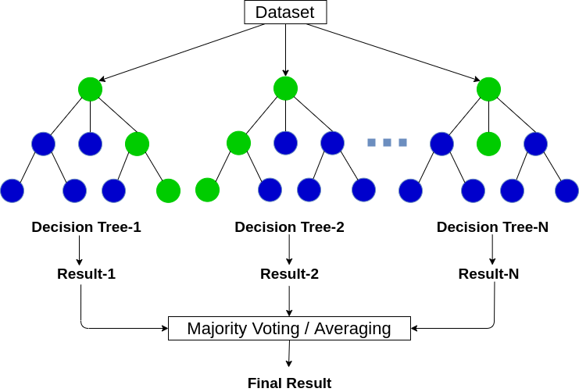
RANDOM FOREST
Random Forest is a tree-based machine learning algorithm that leverages the power of multiple decision trees for making decisions. As the name suggests, it is a “forest” of trees!
But why do we call it a “random” forest? That’s because it is a forest of randomly created decision trees.
Each decision tree in the forest chooses a random subset of records. Also, each node in the decision tree works on a random subset of features to calculate the output. The random forest then combines the output of individual decision trees to generate the final output.
Random Forest is heavily used in applications that use or utilize customer intelligence. Some popular example are customer propensity models (Retail/ Banking), Product Recommendation Systems (e-commerce), fraud analytics (Banking).

Slide 12
Thank You

